Slide 1
Directed Graphs:
Victoria Road Problem

Slide 2
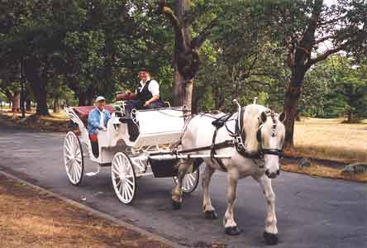
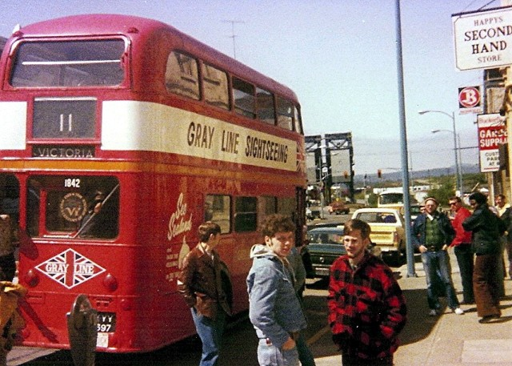
Update: Edge is deleted; Edge is inserted Edge weight is changed
Directed graph problems
A
F

Slide 3
;
Directed graph problems
Reachability (transitive closure) Query: Is there a directed path from A to F?
A
F

Slide 4
Directed graph problems
What is (approx.) distance from A to F? or Update: Change edges incident to a single node.
A
F

Slide 5
Reachability (transitive closure) Query: Is there a directed path from A to F? All Pairs Shortest Paths Query: What is (approx.) distance from A to F? or Query: What is the shortest path from A to F? Update: Change edges incident to a single node. Strongly Connected Components Query: Are a and b in the same strongly connected component? (Is there a path from a->b and b->a?)
1997—Now : many papers

Slide 6
GOALS Reachability (transitive closure) Static cost=O(mn) or fast matrix mult. All Pairs (approx.) Shortest Paths Static cost = Õ(mn ) Strongly Connected Components Static cost = O(m)
Decremental/Fully dynamic
Query/Update time tradeoffs

Slide 7
Kinds of results:
Counting
Decremental single source search (E-S trees, Italano’s reachability trees)
Random nodes & Stitching
Matrix methods
Strongly Conn.Comps.
Zombies (historical local paths) Not Simple
Hop distances and Shortcut edges
Simplest!

Slide 8
COUNTING: Simple monte carlo method for acyclic graph (K, Sagert 1998)
For each pair I, J, keep count of #Paths ( I --> J)
I
C
D
J
Adding (C,D) adds #Paths(I-->C)*#Paths(D-->J)
Subtracting “ subtracts “

Slide 9
But exponentially many!, too large a wordsize so....
Pick a Random prime
For each pair I, J, keep count of #Paths ( I --> J) mod p
I
C
D
J
Adding (C,D) adds #Paths(I-->C)*#Paths(D-->J)
Subtracting “ subtracts “

Slide 10
Works with high probability
Error occurs when #paths = 0 mod p when #paths $≠0$
Where p$∈$[0,…,$n^{c}$],
$n^{c}$has < clog n prime factors, and there are
~$n^{c }/$log n prime numbers
so odds of error ~c$\log^{2}{n}$/$n^{c}$ for one path,
And c$\log^{2}n{}$/$n^{c−2−t }$for all pairs over $n^{t} time$

Slide 11
IDEA 2: Using Even-Shiloach Breadthfirst Trees
A
B
C
D
Recall: O(md) time to maintain deletions only tree to depth d
Idea: DON’T go all the way to depth n

Slide 12
Idea #3: Long paths contain random nodes
If every node is chosen with probability 1/d,
then a path of length d it doesn’t have one is
$$Pr={\left(1−\frac{1}{d}\right)}^{d}≅\frac{1}{e}$$
If prob. Increased to $\frac{cln n}{d} then prob. of failure for any shortest path over n^{a}$
updates = $n^{\left\{2+a\right\}}∗\frac{1}{e}^\{−cln n\} =\frac{1}{{ n}^{c−2−a}}$

Slide 13
Ideas 2&3: Use short trees to deal with
short paths/random nodes to deal with
long paths (deletions only)
Henzinger, K (FOCS 1995), others
For i=1 to log n
Form $S_{i}:$Randomly pick nodes with prob $c ln n$/ $2^{i}$
For each node x and maintain trees of depth $2^{i}$

Slide 14
Forest of Out Trees (E-S Trees) of depth $\log^{2}{n }$for every node to maintain short paths
v1
v2
vn
depth $2^{i}$ > $\log^{2}{n}$
For random nodes chosen with
prob c ln n / $2^{i}$
I.e., O(n/log n) random nodes chosen
r1

Slide 15
To answer query: u → v
check if there’s short path in Out(u)
check for every random r if u $∈$ $In \left(r\right)$and
v $∈Out\left(r\right)$
Cost of Query= #random nodes = n/ log n
Total cost of updates= n (m$\log^{2}{n)}$ for short trees + $Σ$(m $2^{i} )$(n log n/$2^{i}$) for longer trees
=$mn\log^{2}{n}$

Slide 16
From Decremental algorithms to fully dynamic algorithms with large query times
Keep deletions-only data structure for old edges.
Keep track of recently added edges and rebuild single source/sink decremental E-S trees for these.
If there is a query, test if any of the recently added edges is on a new path that needs to be used.
Rebuild deletions-only data structure after enough insertions

Slide 17
Decremental single source Reachability for acyclic graphs (Italiano(1988)
keep a tree of edges to the nodes
The source can reach and
for each node u store its pred.
If an edge {v,w} is deleted, then test if w has a
“hook” to the nodes u can reach. If not, w is not
Reachable. Check its children.
If an edge is considered and found not to be a hook,
It is never a hook for that tree. -> total cost is O(mn)

Slide 18
Decremental Reachability for acyclic graphs (Italiano(1988)

Slide 19
Speed up decremental transitive closure
by maintaining Strongly Connected Components
(Roditty, Zwick 2002)
(then use acyclic method)
v
Randomly chosen v
SCC
Key Idea: As SCC decomposes, random node v is likely to be in LARGEST comp.

Slide 20
Only rebuild In-Out trees for smaller comps.
Total cost ~ cost of largest tree=O(mn)

Slide 21
Only rebuild In-Out trees for smaller comps.
Total cost ~ cost of largest tree=O(mn)

Slide 23
HINT: set$x_{i}=\frac{n_{i}}{n}$
$y_{i}=\frac{m_{i}}{m}$

Slide 24
Shortest (approx.) paths

Slide 25
State of Art for Query time O(1)
Fully dynamic APSP in general graphs to Demetresco Italiano 2003
Decremental
directed, unweighted Baswana,et al
2002
t
Neg edge wts(Thorup)_
Undirected,unweighted Roditty, Zwick (2004)
(improved 2013 FOS Henzinger,Krinniger,
Nanongkal)
Weighted, directed Bernstein 2013 STOC.

Slide 26
First idea: Maintain paths up to length n^{1/2}
Use nodes in S to join short paths together, O(n^{2.5}log n) (K99)
v1
v2
vn

Slide 27
Roditty and Zwick (FOCS 2004)
Decremental (1+ ε) Approximate Shortest Paths (unweighted, undirected) with
Small query time and Õ(mn) total time
For i=1 to log n,
Form $S_{i}:$Randomly pick nodes
with probability $1/\text{ε}2^i$

Slide 28
For i=1 to log n,
Form E-S tree with new node $s_{i}$as source node with edges to the elements of $S_{i}$
For each node u in E-S Tree i, maintain
$p_{i }\left(u\right)$=ancestor in $S_{i}$ . Total cost = O(mn log n)

Slide 29
Using Ideas 3&4:
For each p in $S_{i}$keep E-S tree of depth $2^{i+2}$ (x’s E-S tree to depth i)
Total cost is $Σ$ (n${/ε2}^{i}) ∗m2^{i+2}$=O(mn/ $ε)$
For each node u in E-S Tree i, maintain
$p_{i }\left(u\right)$=ancestor in $S_{i}$

Slide 30
To answer a query what is the approx. distance from (u,v)?
Find smallest i such that $p_{i }\left(u\right)≠ ∅$and $v∈p_{i} {\left(u\right)}^{′}s level i tree.$ Cost=O(log n)
Return dist from $p_{i} \left(u\right)$ to u + dist from $p_{i}\left(u\right) to v$

Slide 31
Return dist from $p_{i} \left(u\right)$ to $u$+ dist from $p_{i}\left(u\right) to v$
$p_{i}$(u) is within $ε 2^i$ of u and
v is within d(u,v) + $ε 2^i$ $of p_{i}(u)$
d(u,v) $≥2^{i}$ or we would have chosen a smaller i
-> returned distance is within (1+2 ε) of d(u,v)
Why does this work?

Slide 32
E-S Trees with pos integer weighted edges , weight increases (k 1999)
A
B
C
D
Similar to Dijkstra’s shortest path alg

Slide 33
Idea 7: Shortcut edges + hop trees E-S + random nodes (Bernstein, 2013)

Slide 34
Idea 7: Shortcut edges + hop trees E-S + random nodes (Bernstein, 2013)

Slide 35
Idea 7: Shortcut edges + hop trees E-S + random nodes

Slide 36
Shortcut edges
Maintain h.SSSP for random sample of nodes
Add shortcut edge (a,b) for all a,b in Sample.
weighted by dist (a,b)
For each sample node run h.SSSP
For every node v
add shortcut edge to each sample node & maintain h. SSSP

